Slide 1


Data Privacy Workshop 26 Jan 2021

Slide 2
Agenda
Background
Setting Up
Privacy Techniques
Conclusion
Feedback

Slide 3
Background
This workshop is designed to provide participants a basic overview and understanding of data privacy concepts and techniques, especially from a government agency context.
In the workshop, there will be hands on python coding to familiarize participants with the available tools and resources of data privacy.
Participants are assumed to have some knowledge on basic python programming and have some experience working with data.

Slide 4




Background
1
2
Tokenization
---
Hashing
---
3
4
Generating Synthetic Data
---
Field Level Encryption
---

Slide 5
Setting up
(1) Download NoGovt agencies: Raise awareness, understand and discover use cases
Private Companies / Knowledge Centres: Evaluate best-in-class industry offerings; explore research partnerships, recommend COTS solutions

Slide 6
Setting up
Install Jupyter Notebook

Slide 7
Hashing
What’s hashing:
Ensure sensitive values (e.g. identifiers) cannot be seen or reasonably recovered in the event of a compromise.
Why perform hashing:
This ensures that even if an attacker were to break into the IT system, the data would be unusable to the attacker
How to do hashing:
Replace sensitive values (e.g. identifiers) with an algorithmically derived value that cannot be reversed easily
Notes:
*Note: this measure is only appropriate for data fields where the actual values need not be recovered, such as passwords or for aggregated data analytics. Strong hashing functions should be used, such as cryptographic hash function, that cannot be reversed with current computing resources.

Slide 8
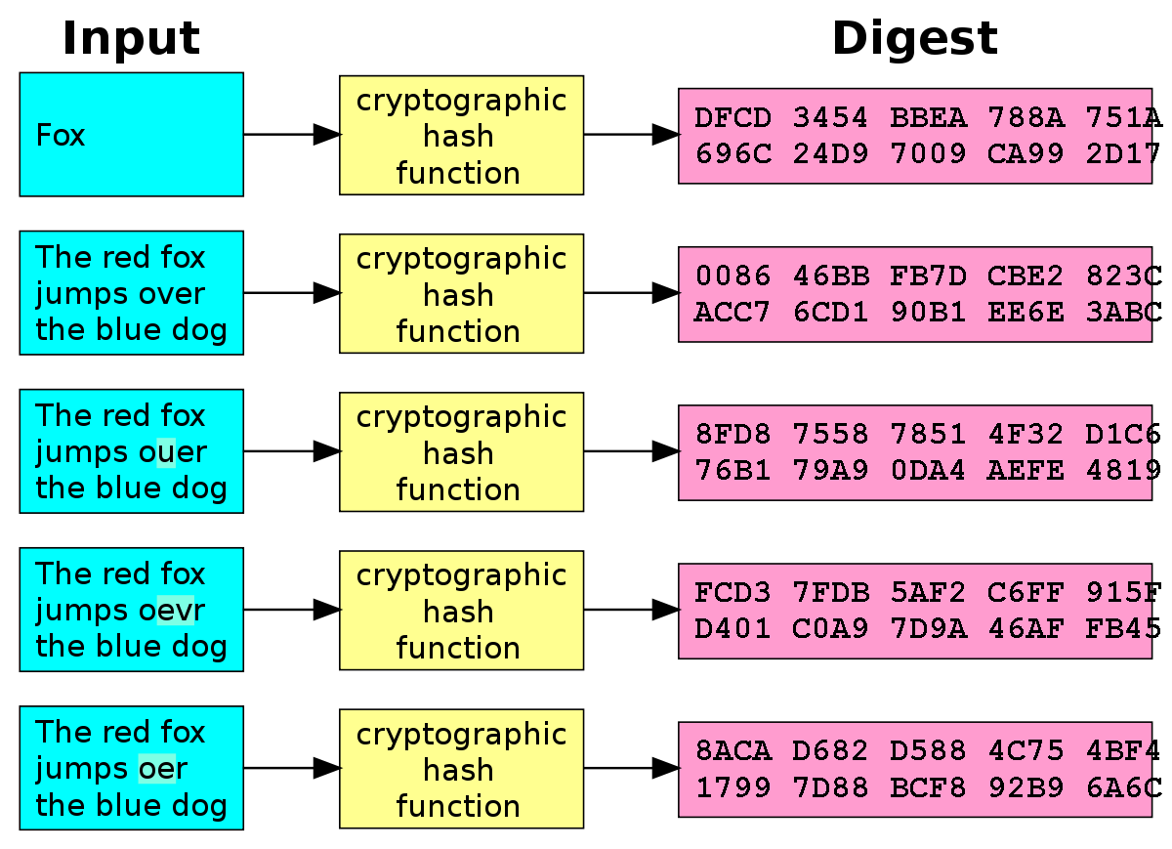
Hashing
One directional
One simple non-cryptographic hash function is the modulo (remainder) operator
Avalanche effect – one bit change can result in a significant change in the resulting hash
Add salt to protect against rainbow table attacks*
Available cryptographic hashing algorithms:
MD5
SHA1
SHA256
* Rainbow tables: pre-computed table of password hash chains used to crack hashed passwords

Slide 9
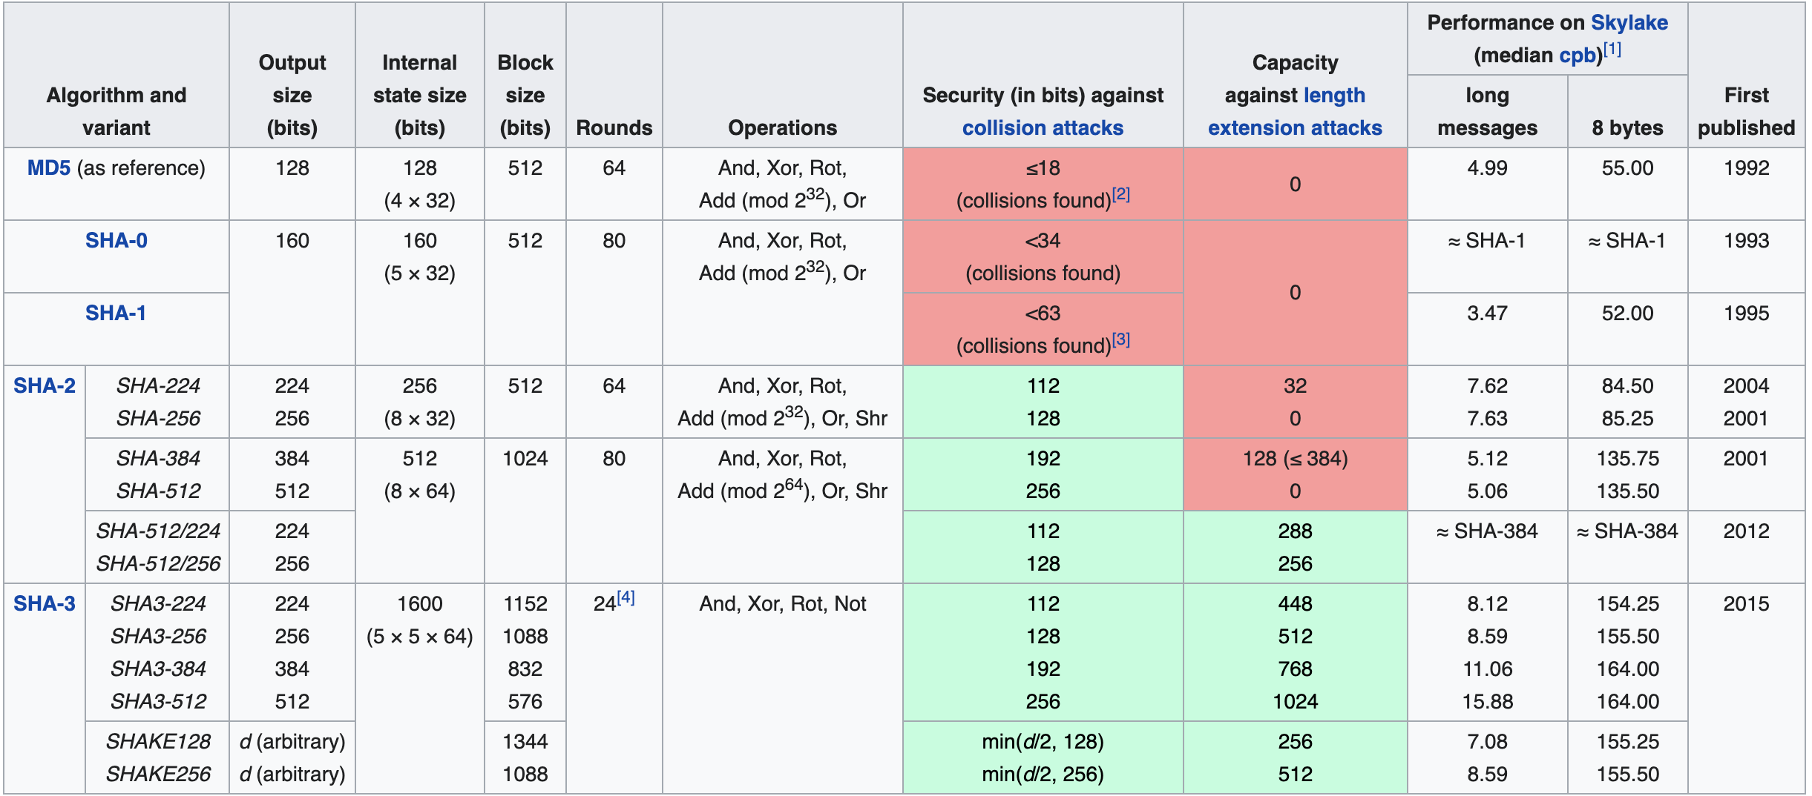
Hashing algorithms at a glance
* Rainbow tables: pre-computed table of password hash chains used to crack hashed passwords
n-bit security means that the attacker would have to perform 2^{n} operations to break it

Slide 10

Code Demo
Hashing

Slide 11
Tokenization
What:
Ensure that identifiers cannot be seen in the event of a compromise
Why:
This ensures that even if an attacker were to break into the IT system, the data would be unusable to the attacker.
How:
Replace identifiers and attributes with a different value known only to the agency. The different values are randomly generated and saved in a lookup table/token vault
Notes:
*Note: the underlying technique of field-level encryption achieves the same function as “T9. Field Level Encryption”.
This technique is appropriate for data fields where the actual values need to be recovered, such as identifiers required for service delivery

Slide 12
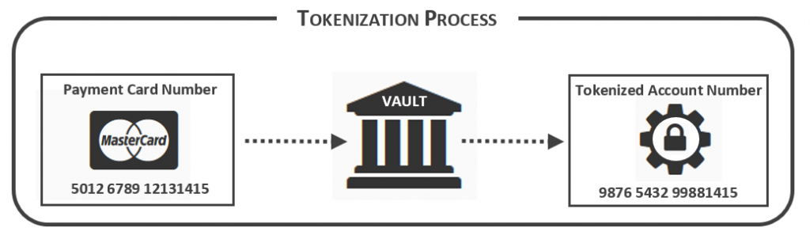
Tokenization
Randomly generates a token value for each original value and store the mapping in a token vault
* Rainbow tables: pre-computed table of password hash chains used to crack hashed passwords

Slide 13
Code Demo
Tokenization

Slide 14



K-anonymity
Whitespace development: Ensure that Public Sector keeps abreast with the latest data privacy protection technology.
4 whitespace trials from FY21 - FY24 (1 trial per year)
Central tools: Ensure that Agencies will have access to data privacy protection tools needed to protect their high risk data sets.
3 central tools by end FY24
Interim: 1 central tool by end FY22
Agency Projects: Ensure that the new capabilities are transited to agencies.
2 POC projects by end FY24
Interim: 1 POC project by end FY22

